Slide 1

& Cultural Heritage
Notes:
CC overview
Museum uses of CC
Highlights: reasons + benefits
Creative Commons is a global nonprofit organization with staff and affiliates across the U.S. and around the world. Our mission is to make it easy for individuals and institutions to access, build on, and help grow the public commons of cultural, educational, and scientific works – that has existed for thousands of years.

Slide 2
A simple, standardized, legally robust way to grant © permissions to cultural works and data
Notes:
To facilitate safekeeping and widespread growth of the commons, we have developed a simple, standardized and legally robust set of tools that allows institutions and individuals to grant © permissions to their works. Before CC, there was no standardized way to do this.

Slide 3

Notes:
CC filled the gap between “all rights reserved” and the public domain. Before CC, an institution could either reserve all rights or give them all way. With CC, an institution can now maintain its copyright, while granting certain reuse permissions to the public.

Slide 4
CC Licenses
Enable © holders to grant copy and reuse permissions to the public
6 licenses:
Some grant commercial uses
Some grant derivative uses
All require attribution
Notes:
CC provides six copyright licenses, free of charge, for any entity to use. All of our licenses means the owner retains her copyright, and all of our licenses require attribution to the copyright owner. But some of these license grant commercial uses while others reserve commercial uses; some grant derivative uses while others reserve the right to remix, translate or build upon the material.

Slide 5




4 Elements
Attribution
ShareAlike
NonCommercial
NoDerivatives
Notes:
CC licenses are made up of four elements: which are Attribution, ShareAlike, Noncommercial, and No derivatives. Since all licenses contain the element of Attribution, you can think of it as the basic element, on top of which you can choose to apply one or more of the additional three conditions.
For example:
- If you want to prohibit commercial uses, you would add the non-commercial condition
- If you want to require that downstream users also reshare their adaptation of your work, you would add the sharealike condition
- If you want your work to be redistributed “as-is” (or verbatim without any significant changes being made), you would add the no derivatives condition

Slide 6
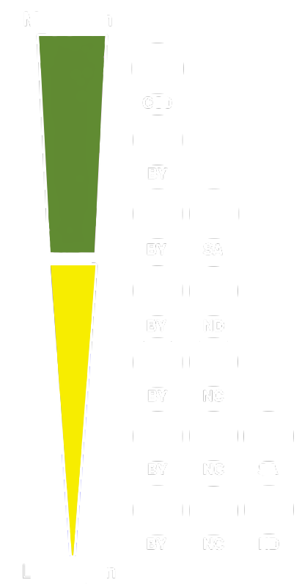
Public Domain Dedication
Licenses
Notes:
These four license elements can be combined legally in six ways, resulting in Six CC licenses. They are featured here on a spectrum of the most open license, which is CC Attribution, to the most restrictive license, which is CC Attribution-Noncommercial-NoDerivatives.
At the top is CC0, our public domain dedication tool, which is another legal tool we offer for those institutions wishing to waive their copyright in a work. In addition to our licenses, we offer two public domain tools which are used the most by cultural heritage institutions. CC0 will figure largely into our examples of museum uses of CC later.
I’ll let Diane explain those next.

Slide 7

CC Zero =
I want to waive all of
MY rights to a work.
(legally operable)
Notes:
CC zero is a tool for your to waive all of your copyrights in a work, effectively dedicating it to the public domain. In this sense, CC0 is often called the public domain dedication tool. CC ZERO = you waiving all of YOUR rights so that you have zero rights left in a work.

Slide 8
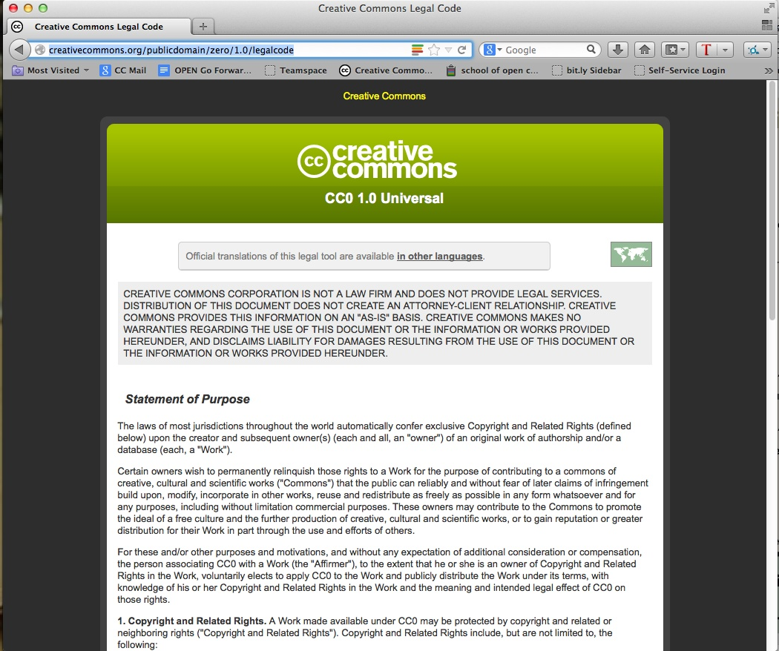
Notes:
CC0 has a legal code beneath it, because it’s a tool for creators to use to relinquish their rights to a work, and you need a legal mechanism to do that.

Slide 9

PD Mark =
For works already in the public domain.
(legally operable)
Notes:
The Public Domain Mark is for marking works that are already in the public domain, not created and owned by you, but by authors long dead and gone. The public domain mark is mainly used by institutions to mark materials archived from hundreds of years ago, or just before 1923.

Slide 10
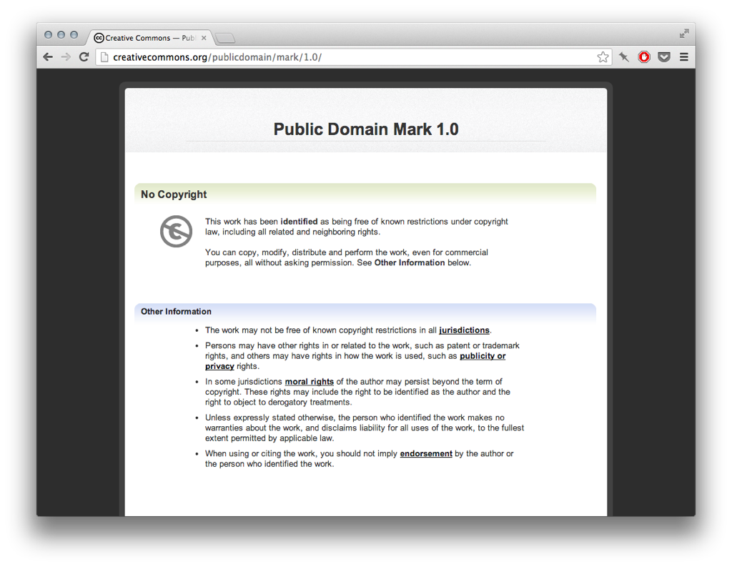
Notes:
This is what the deed for the public domain mark looks like. You’ll see that the language itself indicates that it is more of a tag or label: “this work has been identified as being free of known copyright restrictions…” etc. There is no link to a further legal code beneath this summary, because there is none. It’s just a label to make it easier for other people to see that the work is in the public domain.

Slide 11
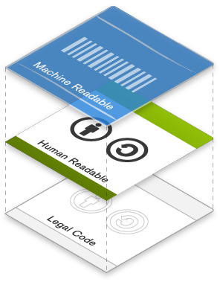
Notes:
All of our legal tools are designed with the web in mind. CC licenses have a unique 3 layer design, which is a fancy way of saying that you can communicate the license in three ways: one way for lawyers, one way for normal users, and one way for machines.
This layered design is part of what makes CC the global standard for copyright licensing.

Slide 12
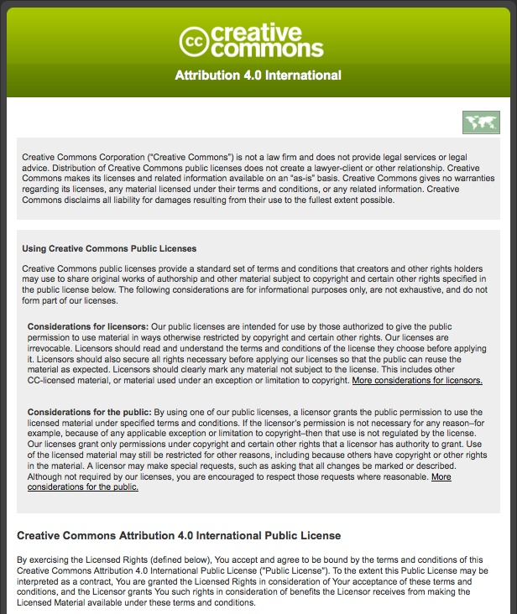
Lawyer
Readable
Legal Code
Notes:
So just a quick snapshot of each - the first, base layer is the actual license, the document that lawyers around the world have drafted and vetted so that the license works like it’s supposed to according to US and international copyright laws. We call this the legal code - written by and for lawyers.

Slide 13
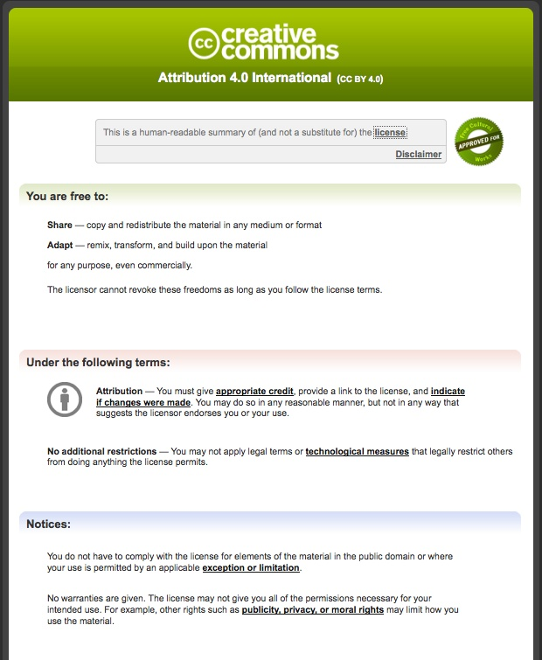
Human
Readable Deed
Notes:
* The second layer is written in a format that any user could read and understand.
* We call this the “human readable” summary of the license, which sums up the most important terms and conditions of the license in non-technical language.
* One way to think of it is as the user-friendly interface to the actual license.

Slide 14
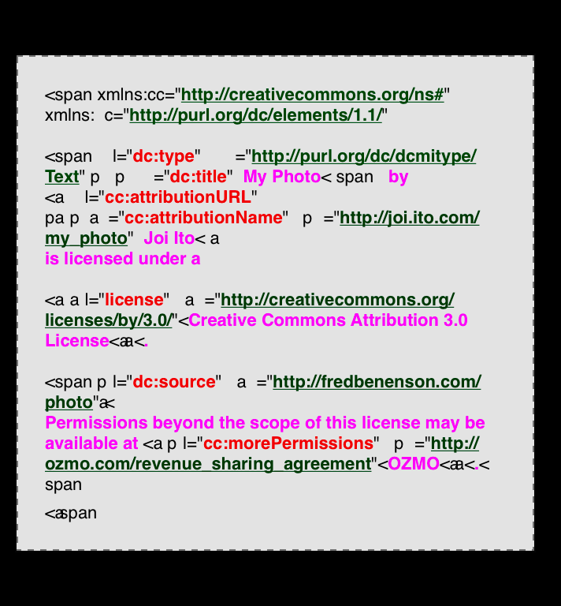
Machine
Readable Metadata
Notes:
* The third and final layer is the machine-readable metadata. This is what really makes our tools really relevant for the digital age. This small snippet of HTML code summarizes the license and associated metadata (such as author and date) into a format that software, search engines, and other kinds of technology can understand.
* We have designed the code so it works web pages, and have made it easy to use by anyone. All you have to do is copy and paste it into you your webpage editor. We also work closely with institutions to get the marking and placement of this right within their larger systems.

Slide 15
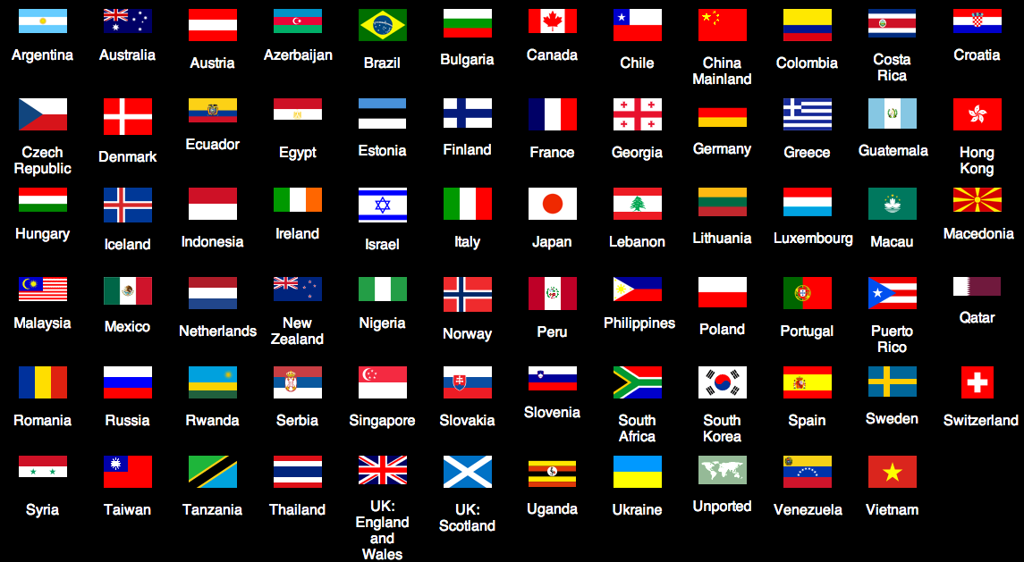

Notes:
The three layers are operable around the world. As I mentioned before, all of our licenses have been designed and vetted by legal experts and aligned to international copyright laws. We have nearly 300 affiliates working to ensure legality and adoption of our tools in 79 countries.

Slide 16
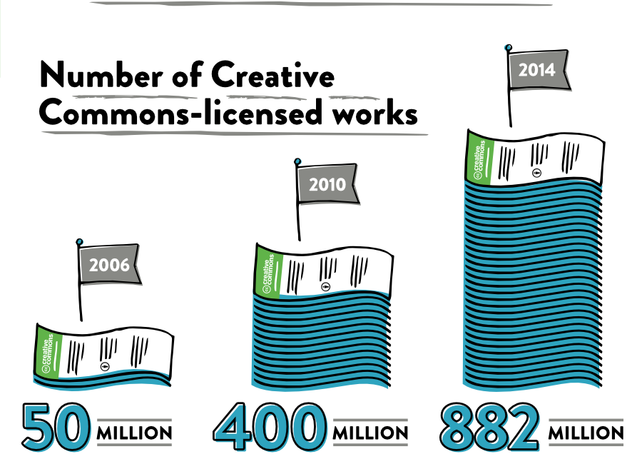
Notes:
We recently issued a SOTC report where Google generously gave us data regarding CC licensed works on the web. The conservative estimate today is that 882 million works exist under CC licenses or CC0.

Slide 17
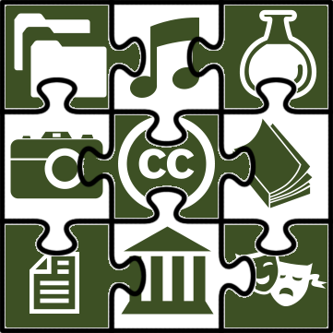
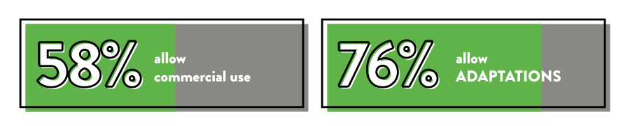
Notes:
And much these works are images, videos, songs, podcasts, government works, educational materials, scientific data, and more.
The trend over the years indicates that more creators are allowing adaptations and commercial use than before. The details of these numbers are available online as part of the SOTC report: http://stateof.creativecommons.org/

Slide 18

+ Museums
Notes:
Many millions of these works are works that have been released by institutions, especially institutions housing works of cultural heritage such as museums.
Museums are using CC in a variety of ways and we want to highlight several of those uses now. Mainly museums:
Are Sharing their Digital Collections – whether those collections are made up of Images, Audio, Video – or a mixture of all three
They are also Sharing Collection Records – catalog data about their collections
And they are also engaging their communities of users, going above and beyond simply sharing their digital collections. They are actually encouraging certain reuses and participation around their collections.

Slide 19
Digital collections
Notes:
CC is the optimal choice for many museums when it comes to sharing their digital collections.

Slide 20
Brooklyn Museum
100k+ online image collection
CC BY for images and text owned by museum; PD for PD works
Most restrictive → most open
2004: CC BY-NC-ND
2010: CC BY-NC
Today: CC BY & PD statement
Notes:
The Brooklyn Museum.
The BM actually has a very interesting story behind its use of CC. BM’s mission has always been about growing community and visitor experience, so back in 2004 they wanted to extend that to their online presence. They decided to add the most restrictive CC license to images and text they owned on their website to encourage user engagement. They had a great experience, so in 2010, they decided to allow derivatives by moving to CC BY-NC. Having a further great experience, they moved to the most open license, CC BY.
At the same time, BM had a vast collection of images of public domain works. They were going through the process of identifying the rights of each object in these images, and they opted to license the images under the default CC license policy for their website – which eventually became CC BY.
Today, more than 10 years later, their entire website and the images therein are licensed CC BY, including the descriptive text for the images. And where the object contained in the image is in the public domain, they have identified that the image itself is also under “no known copyright restrictions” – in line with their contributions to Flickr Commons.

Slide 21
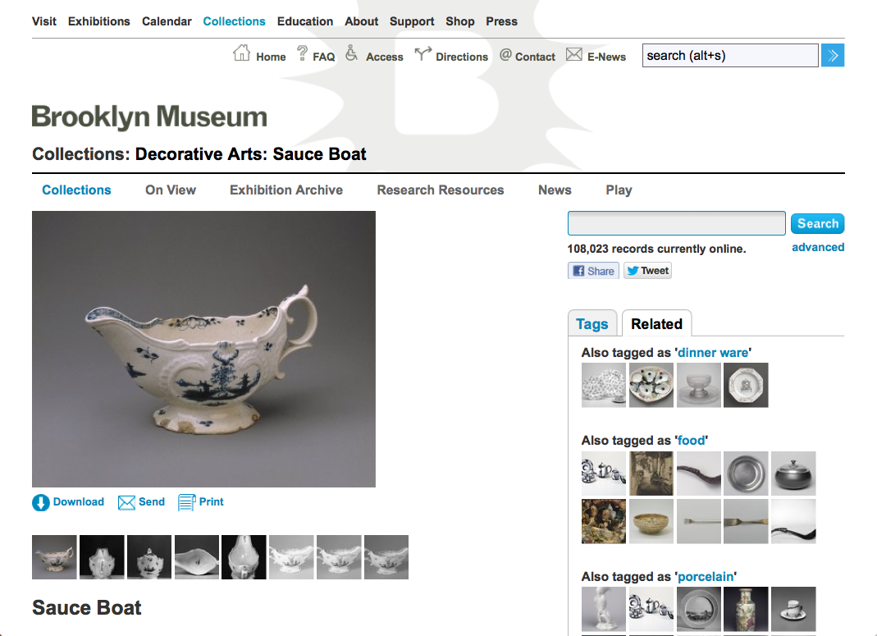
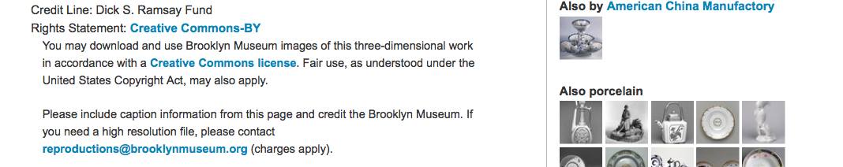


Notes:
So here’s an example of an artifact, underneath which you can see a very clear rights statement that notes that the image is governed by a CC BY license. BM also offers some guidelines here for how to give attribution to BM. The license itself is clearly linked to the license deed so that a user may click on it and read exactly what they can and cannot do with the image.

Slide 22
Rijksmuseum
150,000 images of its public domain collection released via CC0
Initial hesitation, but marketing dept argued that “the digital reproduction of an item would pique public interest in it, leading them to buy tickets to the museum to see the real deal”
Notes:
This second example I’m going to dive a bit more deeply into because of its international impact on museum sharing practices. The Rijskmuseum is the
Dutch National Museum in the The Netherlands, founded 1800, with a focus on art and history
And it contains many of the original artworks of European masters such as Rembrandt and Vermeer, in addition to high resolution images of these and other original artworks
For 10 years, from 2003-2013, much of the physical museum was closed for renovations, but it had 1 million physical items that it wanted to exhibit in some way – so the museum decided to release 150,000 images of its public domain collection to the public
At first the museum was hesitant, but their marketing dept really pushed for release of the images, arguing that they had to keep the public engaged throughout the renovation period and that it would also be a way to extend the reach of the museum beyond the small space it had to showcase during this period of time.

Slide 23
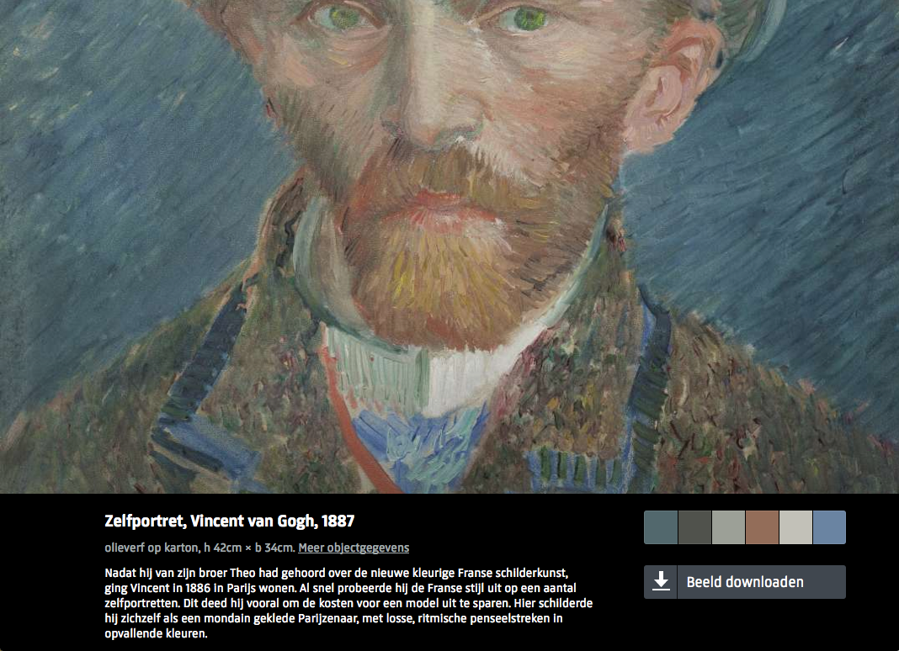
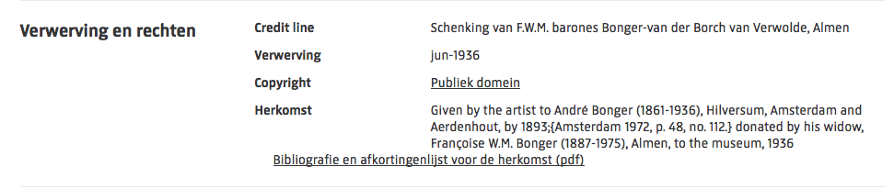

Notes:
So they did it. They released 150,000 high resolution images as large as 200MB into the public domain using CC0. They abided by the principle of unrestricted access to the digital public domain – as in the U.S., faithful digital reproductions of PD works are considered PD in Europe.
Their reasons for using CC were numerous. As mentioned, the museum really saw the release of images as a:
Promotional tool to extend the museum’s reach beyond its own website to other platforms, such as: Wikipedia and educational sites (artstor),
Educate public about its collection via true color images, accurate metadata
They wanted the public to engage with more than what they had on display, which even when the museum was open at full capacity was only ever 8,000 objects out of its 1 million
(And lastly, at this time) many Unofficial digital representations of the R’s works were floating around on the web, which people confused with the R’s own collection. For example: People didn’t believe that the R possessed the originals, or they believed that the poor digital versions were R’s.
Museum staff decided that they would rather people use museum’s official high quality images than bad reproductions which would be associated with the museum.

Slide 24
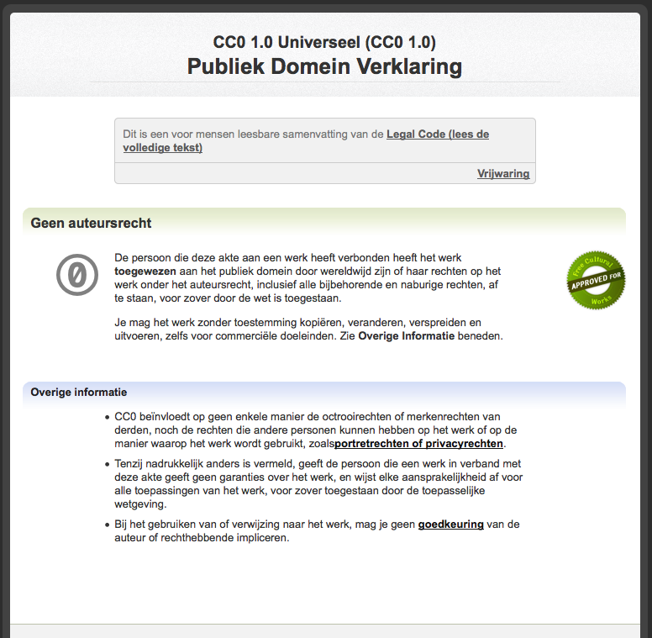
Notes:
So each image’s rights info links to the CC0 deed, which explains that the R dedicates the image to the public domain by waiving any rights it may have, since it does not claim copyright on images of its PD collection.
Process (by which the R released its PD collection is well documented..)
Decision was not made overnight… it took many small steps and internal/external conversations among staff and organizations, including Creative Commons, who was involved from the beginning.. To result in this release of images
Digital collection dept took on a pioneering role: added separate rights tab to their collection mgmt system; marked the beginning of a shift in strategy

Slide 25
Rijksmuseum
Move to open aligned w/greater sales
2010: No images available
2011: First set available via CC BY
2012: CC0; launched Rijksstudio
2013: Released all resolutions under CC0
Notes:
Issues (many issues were considered, including)
Cost to digitization, preservation, storing, cataloging
And the loss of a Potential source of income – licensing fees of high res images esp for merchandizing, which a lot of museums do.
So here’s a rough timeline of their process. Interestingly, their move to release their images resulted in greater sales of the images.
In 2010, they had no images available for free, this was before the museum’s OA policy. Revenue was actually the least amount than the following years once OA policy was put into place
2011: Initial hybrid approach to revenue stream: 2 sized images (4500px) for free, 40 euro for 200MB masters; Revenue more than in 2010
2012: they moved to CC0 for the 4500px images, and they saw a substantial increase in sales, 181,000 euro – but still only .2% of museum’s total revenue. This was more than enough to cover the total cost of employees for that year (100k euro)
Found that admin cost of process image requests was higher for individual requests and less for entities that requested bulk access to a collection
2013: despite steady increase in revenue they decided to do away with the tiered offerings and release all files of all resolutions under CC0, and instead refocus their resources and efforts to generate project funding from art foundations that would digitize entire collections
They felt Admin costs were much lower for bulk digitization; image sales were a relatively small percentage of the museum’s overall revenue; so did away with it in favor of currying good will with the public and using CC as promotional and educational tool

Slide 26
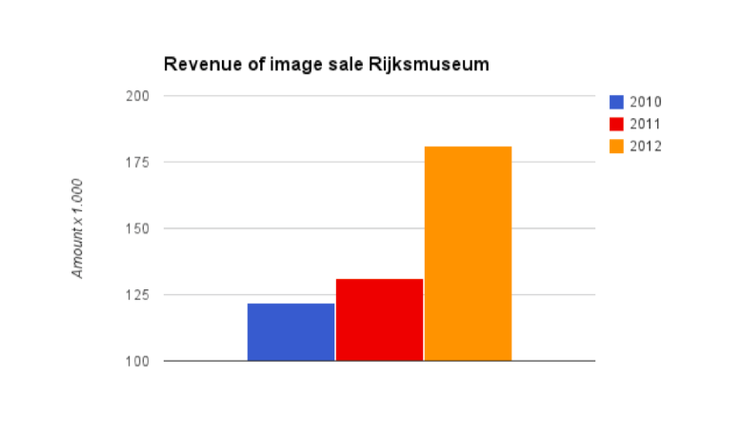



by Joris Pekel
Notes:
So this is a graph showing the increase in revenue since they started releasing images first under CC BY, and then CC0 in 2012.

Slide 27
Rijksmuseum
Promoted museum beyond staff capabilities
Curried goodwill w/public, creative industries, funders
Would they do it again? “Yes, but a lot faster.” – Museum staff
Notes:
So the Results of releasing 150,000 images into the public domain increased the museum’s exposure, esp during a time when much of the physical museum was closed. It definitely promoted the museum well beyond existing staff capabilities and the reach of the museum was international, not just local as it might have been during this time.
It curried a lot of good will with the public but also New audiences with developers, designers, and their social networks.
The R was featured in several “museum of the future” case studies, they were invited to conference panels, and were covered by international media (nytimes) even while closed (2003-2013)
And perhaps importantly for the museum staff themselves, it Resulted in restrategizing around funding – to run more cost-effective programs
And when asked whether they Would they do it again? Staff were very much in the affirmative, that they would do it even faster had they known the results.
--
Move from CC BY to PD aligned to museum goals/principle and was practical
Believed in PD access to PD works
Impossible and undesirable for museum staff to police attributions every time an image is used

Slide 28
Isabella Stewart Gardner
The Concert podcasts and music library are shared via CC BY-NC-ND
CC as promotional tool; 40k downloads from 83 countries in first 6 weeks
CC “key” to success; reached hundreds of thousands more people
Notes:
AUDIO
So this next example is focused on licensing audio for reuse. The Isabella Stewart Gardner museum was one of the first major museums to adopt CC. The museum is based in Boston and they are known for their music program, lectures, symposia, and artist-in-residence educational programs. They have a weekly concert series every Sunday, and prior to adopting CC, only a few people would be able to attend these amazing performances by master musicians given the limitations of the physical space.
The director and curator of the music series wanted to find a way to share recordings with the public, esp those who couldn’t the series, or who lived too far away to, so they adopted the CC BY-NC-ND license.
In this case, they opted for the most restrictive license as a first step into the sharing world (this was also several years ago) because their purpose was simply to distribute the podcast as widely as possible. They weren’t as interested in encouraging derivative uses; they simply wanted more people downloading and listening to the podcast.
CC as a promotional was a success – within the first 6 weeks they had 40,000 downloads from 83 countries, and they were able to reach hundreds of thousands of more people than had they not explicitly made the podcast available for download under the clear conditions of the license.

Slide 29
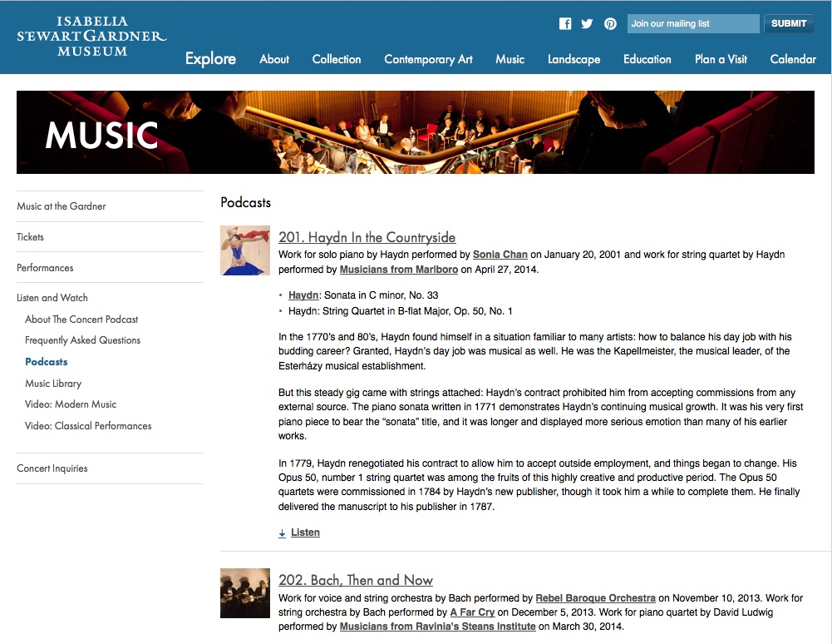


Notes:
“The audio files contained in our podcasts and music library are given to you under a Creative Commons license”
* In addition to The Concert podcast, they have other podcasts and a music library also available for download and sharing.

Slide 30
Isabella Stewart Gardner
“…making these high-quality recordings free and shareable is a major part of why The Concert has been so successful. In thinking about the podcast, it was important to us to really embrace the way people are listening to music today.”
Notes:
We interviewed the director several years ago, and she said that …
One caveat is that we have not revisited the Gardner museum staff in a while, so it would be interesting to reconnect with them to get an update on the numbers of downloads and also whether they might consider moving to a different license, especially because if they moved to a more open license, the museum’s audio could be featured on Wikipedia, which would result in even more exposure and promotion for the podcast, but also the museum.
So that’s one important thing to consider - Wikipedia only allows content that is CC BY-SA or more open.

Slide 31
Statens Museum for Kunst
100 educational videos via CC BY
160 high res images via CC0
Like BM, moved to more open:
Originally considered CC BY-NC-ND, but chose CC BY in 2009
Today: CC0
Enabled exposure on Wikipedia
Notes:
VIDEO + images
So we’ve gone examples of image and audio collections – this museum the Statens Museum Kunst which is otherwise known as the
National Gallery of Denmark in Copenhagen;
Has also released videos using CC, in addition to images of Danish, Nordic and European art that are in the Public Domain;
SMK’s goal was to make their collection not just widely available as possible, but to make their collections and research available in a way that would result in new discoveries, relations and meanings by users and researchers
Like the BM, they ended up moving from more restrictive to more open when it came to license choice. A large part of of that move came because of
The Google art Project which they joined in 2011. They realized they were giving use rights of images to a private company, so they could no longer justify charging public for same rights. This resulted in a pilot project where they released 100 educational videos and 160 high res image files, some up to 440 mb, under CC BY.
Eventually they moved to CC0 for their public domain images.
Because they opted for CC0 and CC BY, their images and videos are able to be featured on Wikipedia
--
"When SMK releases images of 160 artworks under CC BY, it means that we in Wikipedia (as well as the other Wikimedia projects) are able to write better articles about both the artists, the artwosks, and the motifs. One example: In 1646, Jan van Goyen painted a prospect of the city of Arnhem. This image is not only fit to illustrate the article about van Goyen, but also the one about Arnhem, 1646, tonal landscape painting, and tulipomania - not just in Danish, but in all the languages that Wikipedia is available in. Furthermore, images and texts can be reused elsewhere on the Internet to the benefit of many more users."

Slide 32
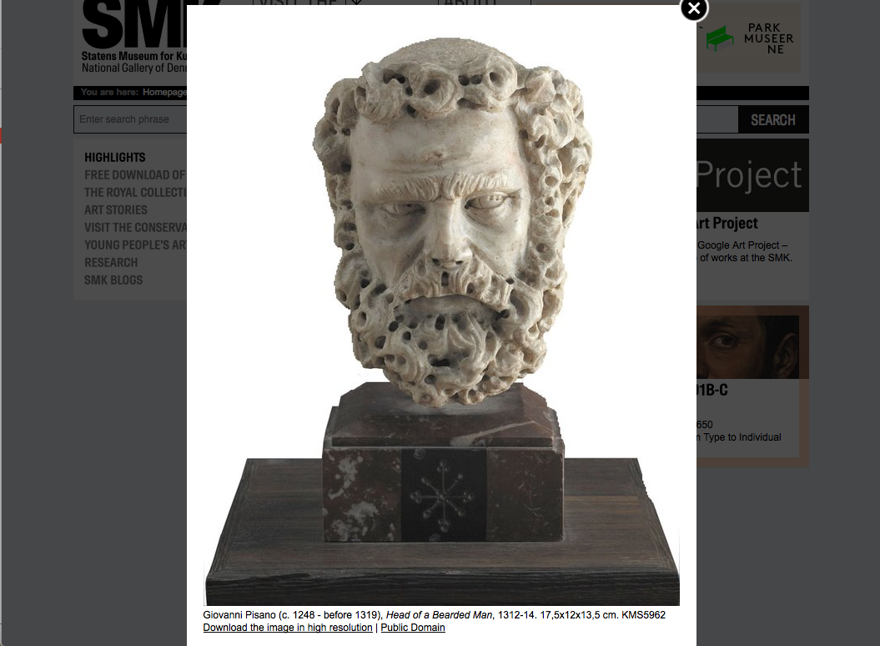
Notes:
So here’s an example of one image for their collection, and you’ll see public domain and download link there. They also offer bulk download of their image files.

Slide 33
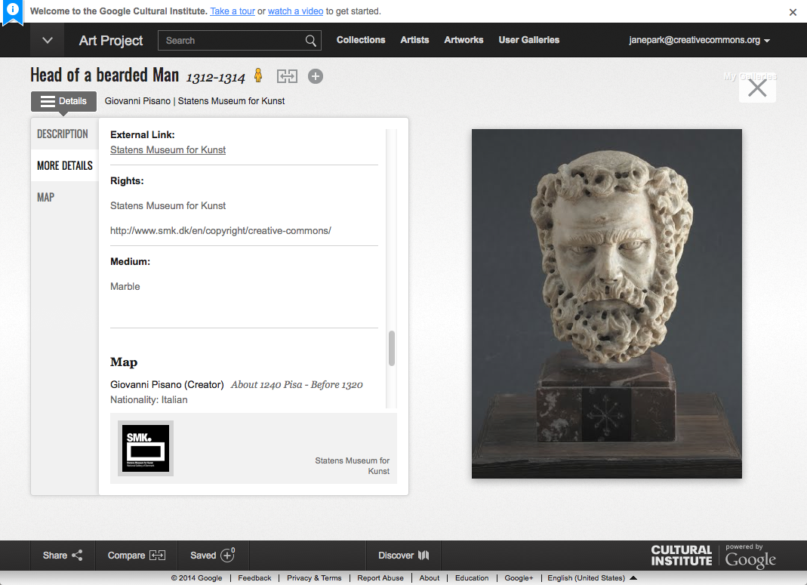
Notes:
This is the same image as part of the Google art project, also under the same CC0 terms.

Slide 34
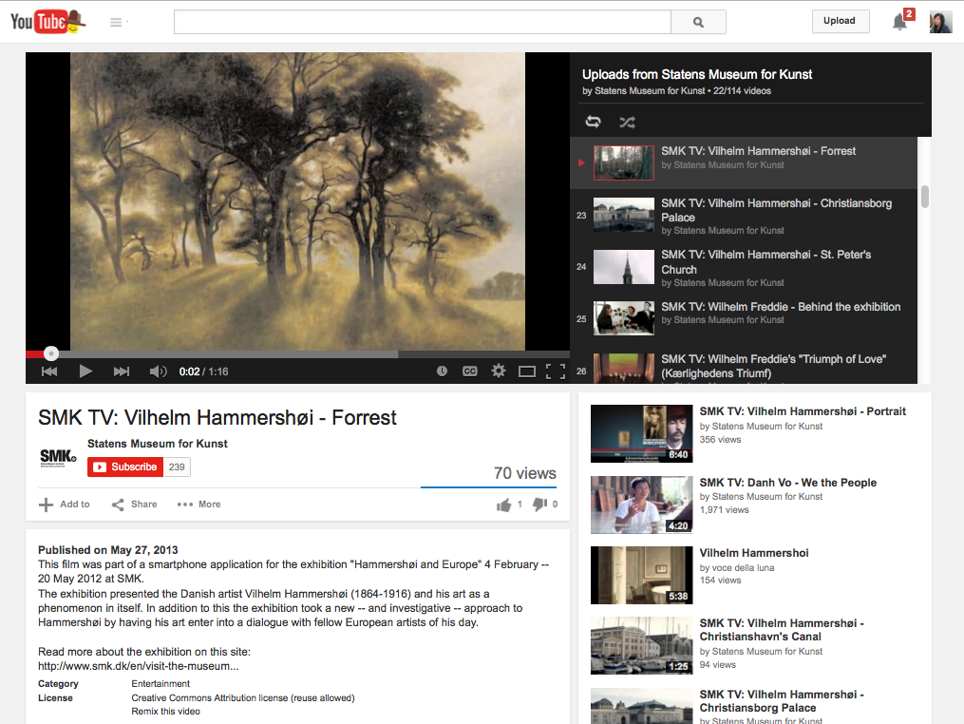
Notes:
And this is their YouTube channel where they are making available videos about these images under CC BY. YouTube allows CC BY licensing within its platform, so any entity can easily mark their videos under this license.

Slide 35
Statens Museum for Kunst
“Use = Value”
“[Our public domain collections] don’t belong to us; they belong to the public. Free access ensures that our collections continue to be relevant to users now and in the future.”
Notes:
https://wiki.creativecommons.org/Case_Studies/Highlights_from_SMK,_The_National_Gallery_of_Denmark
In one of these YouTube videos there’s actually a great interview with SMK staff, where they talk about how their
understanding of quality and control really changed with this pilot project. They realized How they as a museum should handle their digital collections.
A direct quote “They don’t belong to us; they belong to the public. We’re here to look after them and make them available and useful to the public. Use = value.”

Slide 36
Walters Art Museum
20,000+ images
CC BY-SA for photos of 3D artworks
Public domain for photos of 2D artworks whose © has expired
Donated to Wikimedia Commons; supports Wikipedia articles - 10 million views
Notes:
So that’s SMK.
Coming back to the U.S.– the Walters Art Museum is based in Baltimore, and this example is similar to the others who have released image collections, but I wanted to highlight them given their close and successful collaboration with Wikipedia.
So the Walters Art Museum have donated over 20,000 images to Wikimedia commons, the repository for Wikipedia. Many of these photos are public domain photos or otherwise marked as CC BY-SA. The photos are featured on Wikimedia Commons and also on the Walters Museum own website
Since donating these images, thousands have been used to illustrate Wikipedia articles about the museum and also about the art that the museum houses. And they have been viewed over 10 million times as of 2013

Slide 37
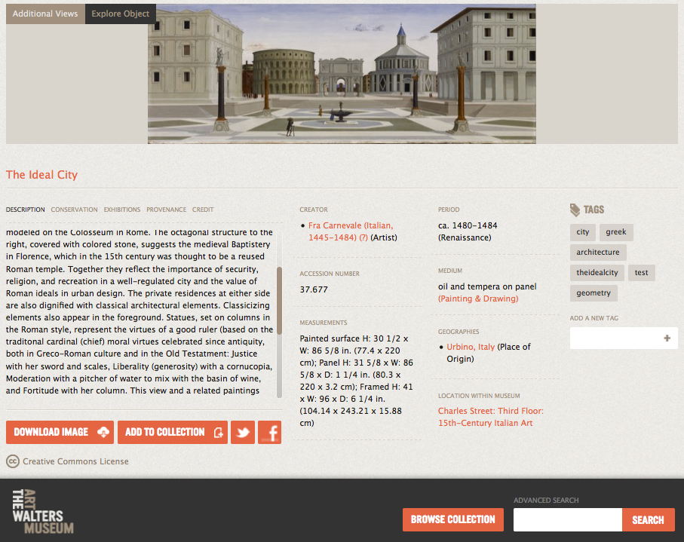

Notes:
Here’s an example of a 2D public domain work on the Walters website, marked with a no known copyright restrictions notice.

Slide 38
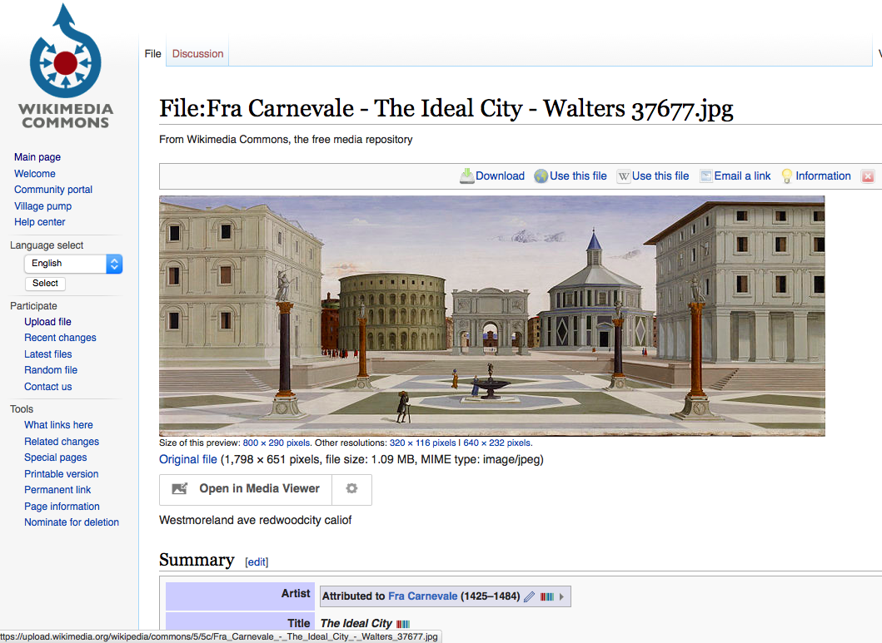
Notes:
The same image is here on Wikimedia Commons with the same public domain notice.

Slide 39
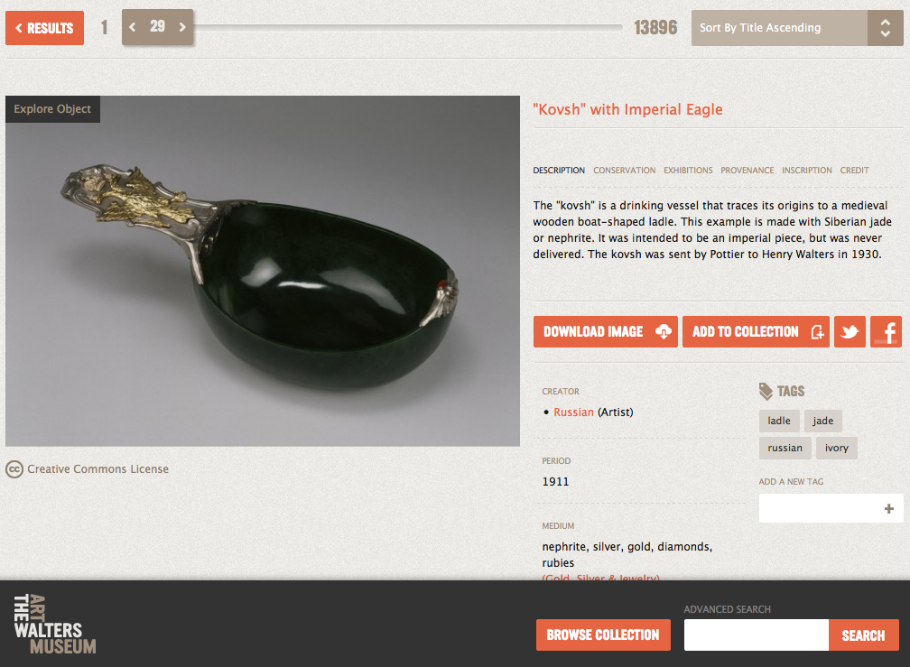

Notes:
And here’s an example of a photo of a 3D image under CC BY-SA.
Walters has collaborated with Wikimedia in other ways, including a Wikipedian in Residence who has written articles about the museum on Wikipedia
And Wikipedia members have also worked with the Walters to transcribe and translate rare Latin documents for the museum which will be made available online.

Slide 40
New York Public Library
20,000 cartographic works released as high resolution downloads via CC0
CC0 for digital reproductions b/c maps are in the public domain
“We believe our collections inspire all kinds of creativity, innovation and discovery."

Slide 41
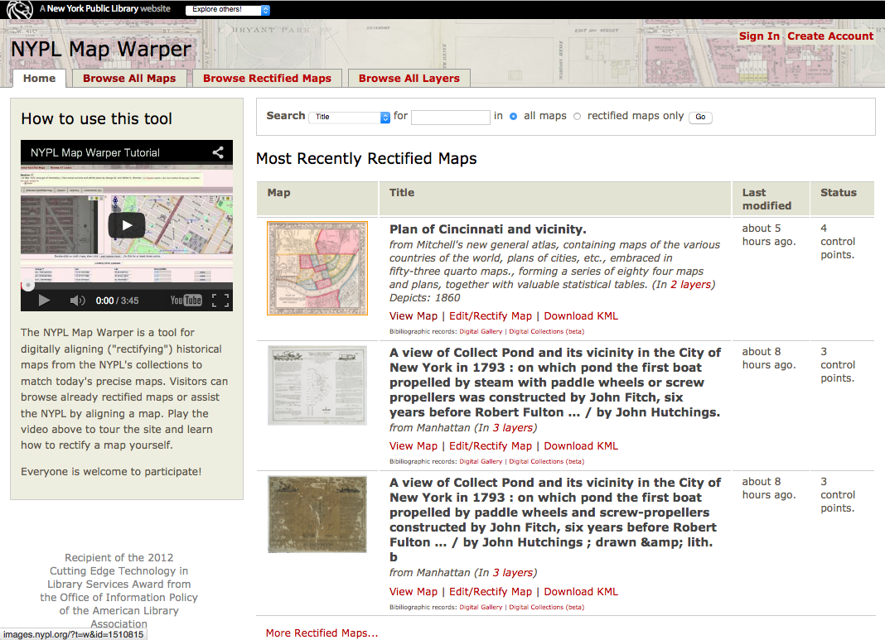

Slide 42
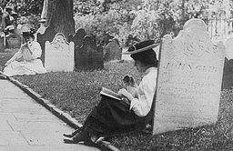
Collection Records
Notes:
So let me pause there for any questions b/c I know that was a lot of information. And maybe Diane wants to say something about the curatorial process before we dive into collection records.
Thanks Diane. Ok so on to collection records. Museums call them collection record or tombstone records, basically data about the collection resource in question, stuff like born, lived, died, dimension, data about data.
In the U.S. any facts/data that have no creative element are considered public domain, but large collections of data are not always made available by institutions, and and even when they are, it’s not always clear to the end user that they are free to use that data.
Add tombstone! https://www.flickr.com/photos/library_of_congress/8147805521
Born, lived, died, date, dimensions, etc. aka “metadata” – or data about data

Slide 43
CC0 Metadata Records
NYPL – 1 million records
Europeana – 30 million records
Harvard Library – 12 million records
Digital Public Library of America – 8 million records
Smithsonian Cooper-Hewitt – 75% of its collection
Notes:
So, here are some examples of museums and other institutions who have made available their catalogs or collection records in bulk, and made it very clear that these records are in the public domain by using the CC0 dedication.
And that’s the example I’m going to dive deeper on here..

Slide 44
Smithsonian Cooper-Hewitt Museum
75% of documented collection data available for download via CC0
Collection data is “the raw material on which interpretations through exhibitions, public programs, and experiences are built.”
Notes:
The Cooper-Hewitt is an amazing design museum. They recognized that its collection data should be free so they made it available on GitHub via CC0.
Museum staff posted a great blog about why they think releasing metadata is important, they said
It’s important to remember that “collection metadata is not the collection itself” but rather that it’s a tool for discovery
Cooper Hewitt calls collection data the raw material…
A great graphic for illustrating that concept is here: http://labs.cooperhewitt.org/2014/the-api-at-the-center-of-the-museum/. You can see the collection database at the very bottom, and then see how programming interfaces can be built on top of that, and on top of that websites and applications and data visualizations.

Slide 45
Smithsonian Cooper-Hewitt Museum
“The release of such data into the public domain brings closer a future in which cross-institutional discovery is the norm.”
Notes:
Another quote from the museum..
--
GitHub for those of you know who aren’t familiar is a source repository traditionally used by developers. Over the years many have used it for verisoning all kinds of projects, and it is especially ideal for making available datasets thanks to the ability track changes and versions over time.
Cooper Hewitt chose GitHub b/c it didn’t have its own repository

Slide 46
Europeana
Digital library for all of Europe
16.5+ million objects in public domain, CC0, or under various CC licenses
30 million records released via CC0
Users can search & browse by reuse rights
Notes:
Europeana is a digital library for all of Europe and they have millions of items under CC0 and various CC licenses.
Europeana: 30M metadata items under CC0, 5 million digital object with PDM and 2.8 million digital objects under one of the CC licenses

Slide 47
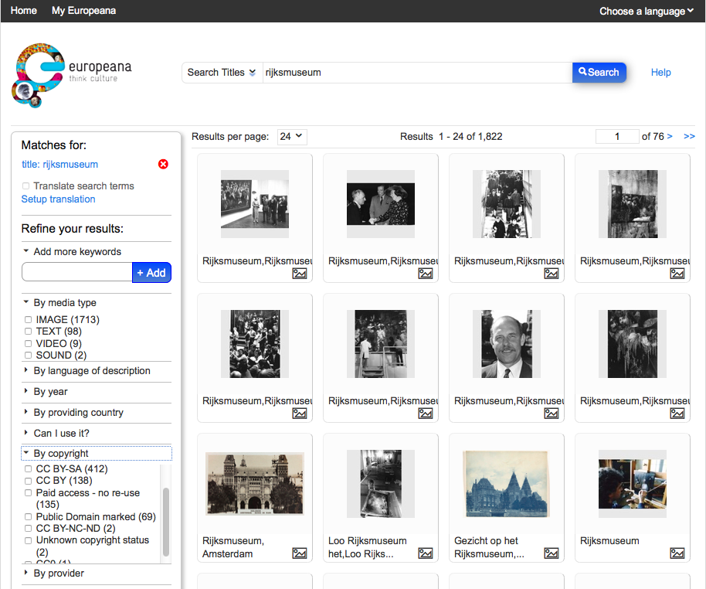
47
Notes:
They have added rights info to all of their resources so that you can search by CC license and for items in the public domain.

Slide 48
Digital Public Library of America
8 million records from U.S. libraries, archives, museums under CC0
One portal to search & browse through distributed resources
App Library – developers building apps using open data

Slide 49
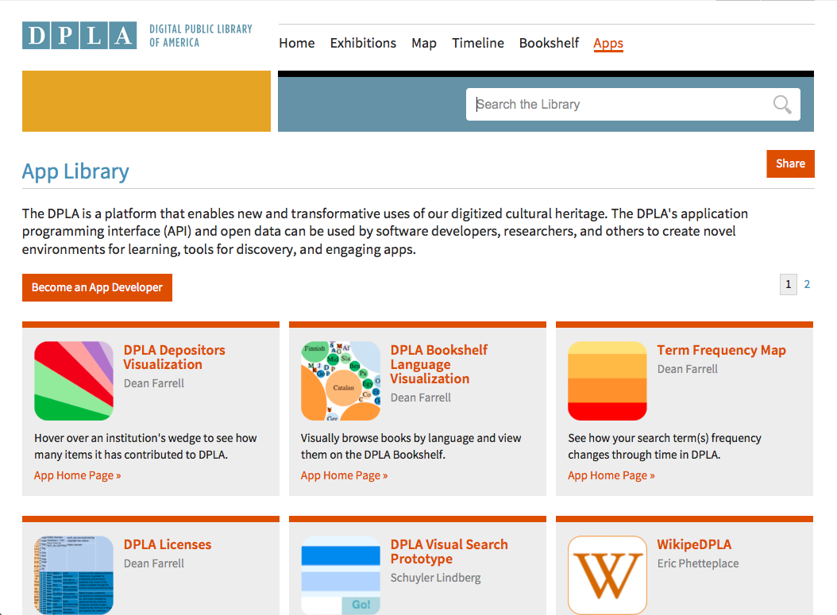
Notes:
Are there

Slide 50
Engaging Users
& Artists
Notes:
So to give you an example of what has resulted from the Cooper Hewitt sharing its data, I’mg going to tie it to how museums in general are engaging their users and community. These are examples of museums who are not just releasing their collection records or images or podcasts in hopes that the public will access them, but who are going above and beyond by encouraging creative reuses and dialogue around their collections.

Slide 51
Smithsonian Cooper-Hewitt Museum
Invites users to tag collection with their photos from Flickr, Instagram
Users can help identify errors and submit corrections to collection data
Encourages users to cite objects in Wikipedia
Notes:
So the Cooper Hewitt not only releases its dataset to the public, but it also invites users to add additional metadata by tagging the collection with their own photos from flickr, instagram and other social networks.
CH also asks users to help identify errors in the collection data and to submit changes – a way to crowdsource corrections.
CH also makes it easy for users to cite CH objects in Wikipedia articles, which in turn increases exposure to the museum.

Slide 52
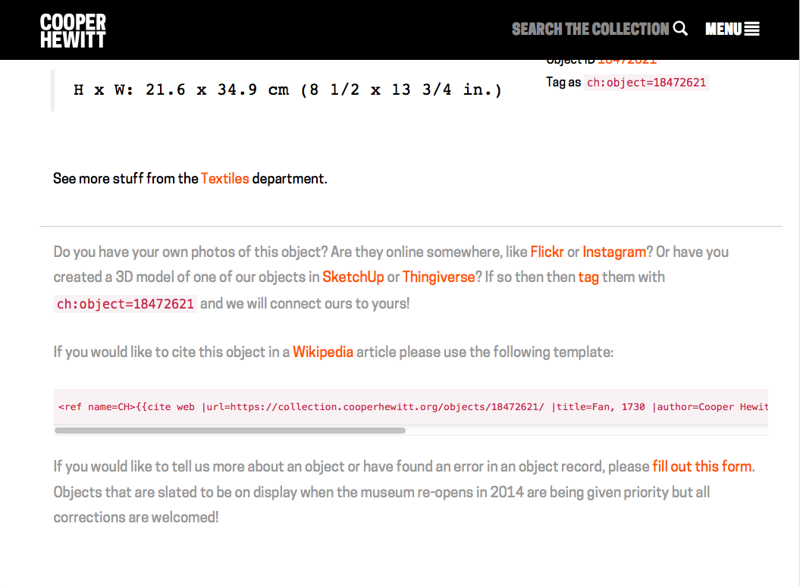
Notes:
https://collection.cooperhewitt.org/objects/18472621/
* So this is the text that follows every object feature on their website. On pretty much every object page they encourage users to participate in these ways.

Slide 53
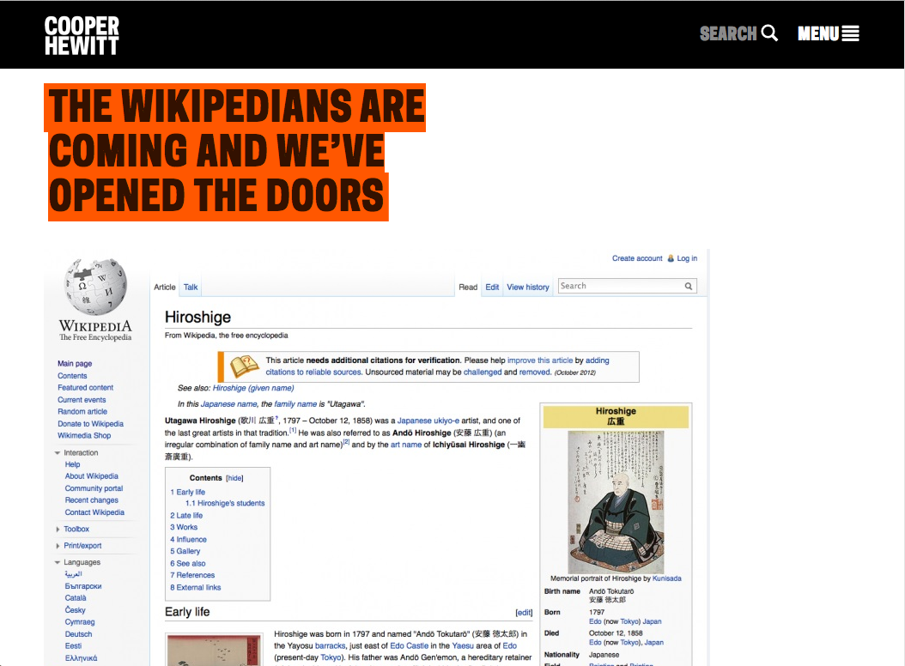
Result: Wikipedia is largest source of traffic from other websites – more than FB, Twitter, Tumblr, etc.
Notes:
http://www.cooperhewitt.org/2013/02/25/the-wikipedians-are-coming-and-weve-opened-the-doors/
* they posted a blog about the results of encouraging Wikipedia use within the community. They found that Wikipedia was the largest source of traffic from external websites to the hewitt’s own website, more than FB, Twitter, Tumblr or any other social media platform.

Slide 54
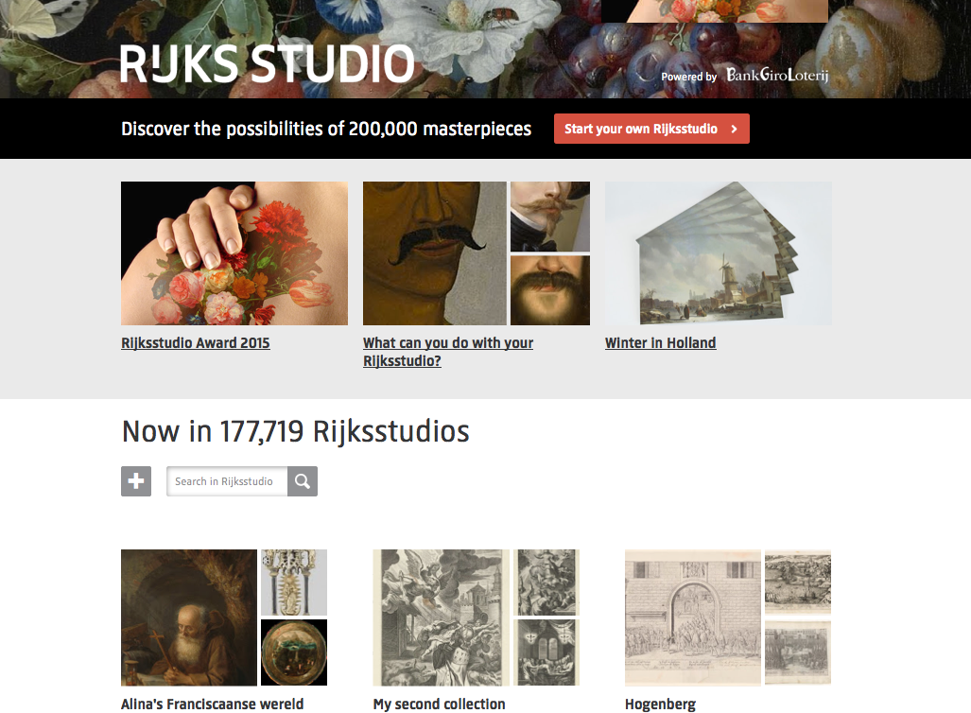
Notes:
https://www.rijksmuseum.nl/en/rijksstudio?ii=0&p=0
Another example of community engagement is from Rijksmuseum. As you recall the museum had released 150,000 images into the public domain. But they didn’t stop there, they set up rijsksstudio not long after releasing the images to encourage their community to build creative projects based on the images. More than 177,000 creative projects have been built in response.

Slide 55
Rijksmuseum
API + Rijksstudio – 177k user contributions
“Open Cultuur Data” competition
2,000+ images feat. In Wikipedia articles – 10 mil+ views
First results in Google Image Search
Notes:
The R is all about Multiple access points to its collection
In addition to Rijksstudio, their images are hosted on External platforms such a Wikimedia Commons and Artstor
Open Cultuur Data competition
They have Released data /high res files (1600x1300px) of well-known works, eg. Van Gogh, Vermeer, Rembrandt for an open data competition
“If ppl are going to work on our collection we might as well give them the best stuff we have”- another urge by marketing dept
Core goal: get public familiar with our collection; internet can greatly facilitate that
Argument: making images available cannot endanger our existence; it can only pique public interest and lead to greater ticket sales
Which resulted in their dataset being the Most used data set in the competition, resulting in a lot of attn for Rijksmuseum
Success led to internal discussion on what else could be done, new Digital Strategy (Digital Manager for museum presented at Museums and the Web conf)
The High res images released are also now the first results in google image search, which leads users back to the R website.
On their own website they notes whether an object is on display in museum currently

Slide 56
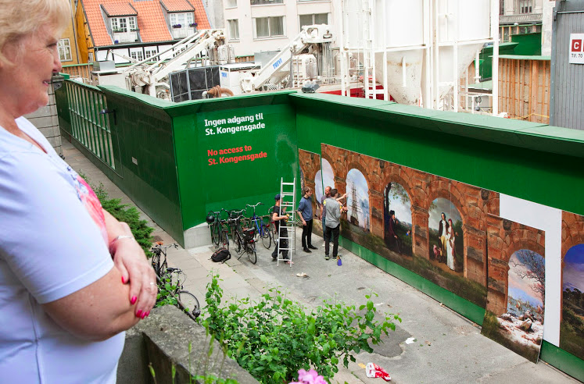
by SMK
Notes:
Last but not least, the previously mentioned Statens Museum for Kunst in Denmark
Had a great Remix Art on the Copenhagen Metro fences project: http://openglam.org/2013/07/08/2353/
Where they partnered with the Copenhagen Metro Company + SMK + Artists remixed images for a wall surround the Metro when it was under construction not too long ago
It Resulted in positive attn with media and public; Spurred a collaborative spirit with danish museum community
Not to mention that it replaced an eyesore with a beautiful mural of PD artworks

Slide 57
Statens Museum for Kunst
Bring our collections to the public
Collaborate w/communities of users
Provide framework + resources, then step back and see what people do
Let go of control over how our collections are perceived, used, & create meaning and value to people
Notes:
“Paradoxically, in this case it is not so much the museum, but the users, who worry about misuse and vandalism towards the artworks’ integrity when they are shared openly with the public.”
*these are reasons SMK stated for the collaboration. They really wanted to ..
*..and the wall is what resulted!

Slide 58
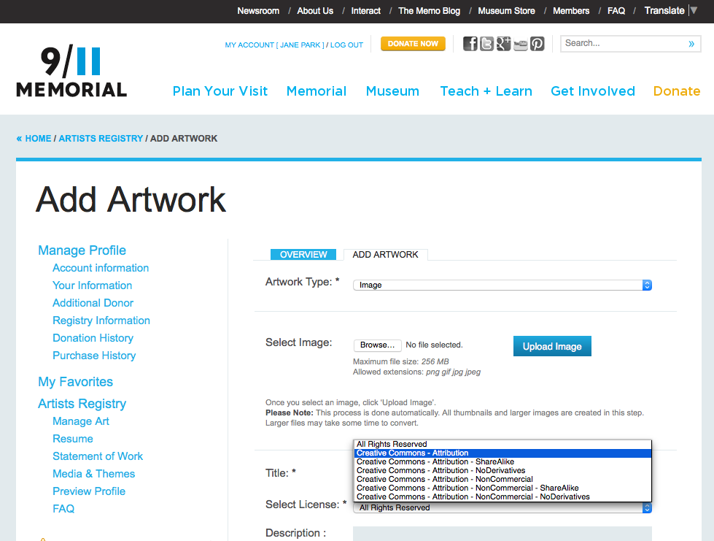

Slide 59
9/11 Memorial Museum
Artists Registry for sharing artworks in response to 9/11
Artists choose how they want to share their art under CC
Artworks have been used in news stories and multimedia timelines of 9/11

Slide 60
Engaging
Users +
Community
Sharing
Digital
Collections
Sharing
Collection
Records
Notes:
So you can kind of see by now that sharing digital collections and collection records naturally leads to engaging and growing users for a museum, in addition to bringing wider exposure for the museum’s collection.
A variety of benefits result for the museum when it opens up its collections in even the smallest ways, as evidenced by the move from more restrictive to more open by many museums over time.

Slide 61
CC licenses are robust, built on © law
Clarity and specificity regarding use
Data embedded w/assets; enables browse/search filters
Minimizes overhead for individual transactions
Clear way to share PD collections

Slide 62
Promotional & educational tool
Increases reach + impact of museum
Good will w/public, creative industries
Enable unexpected, creative & delightful results
Lead to refocusing of resources, new funding + revenue models

Slide 63
Except where otherwise noted: CC BY creativecommons.org/licenses/by/4.0
Creative Commons and the double C in a circle are registered trademarks of Creative Commons in the United States and other countries. Third party marks and brands are the property of their respective holders.

